Slide 1

Data@anz virtual experience program
~ Rushikesh SHinde

Slide 2

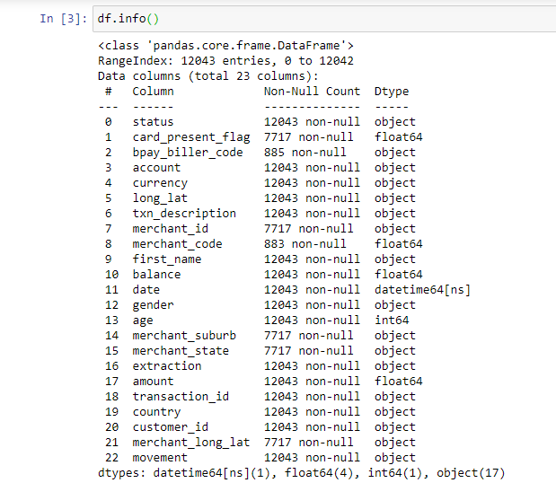
Task 1- Exploratory data analysis
Activity Performed –
Loaded the ANZ synthesised transaction dataset in Jupyter Notebook using Python Pandas.
Observed the missing values in data.

Slide 3

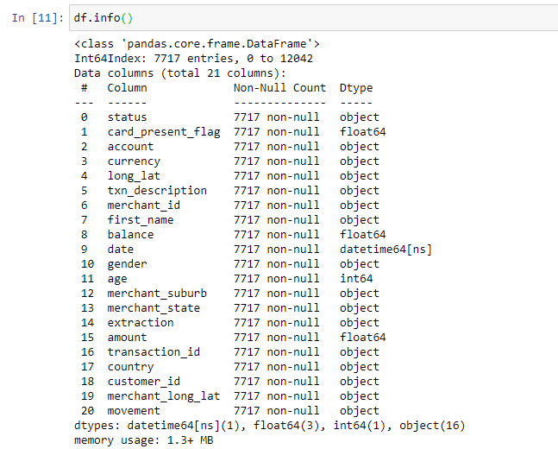
Task 1- Exploratory data analysis
Activity Performed –
2. Observed the missing values in data and Performed data cleaning.
3. Understood the attributes in the dataset

Slide 4
Task 1- Exploratory data analysis
Activity Performed –
4. Using Tableau for Exploratory Data Analysis on the cleaned dataset.
5. Gather some interesting overall insights about the data such as –
Average transaction amount per month
No.of transactions do customers make each month, on average
Visualise transaction volume and spending over the course of an average day
Insights drawn from the location information

Slide 5
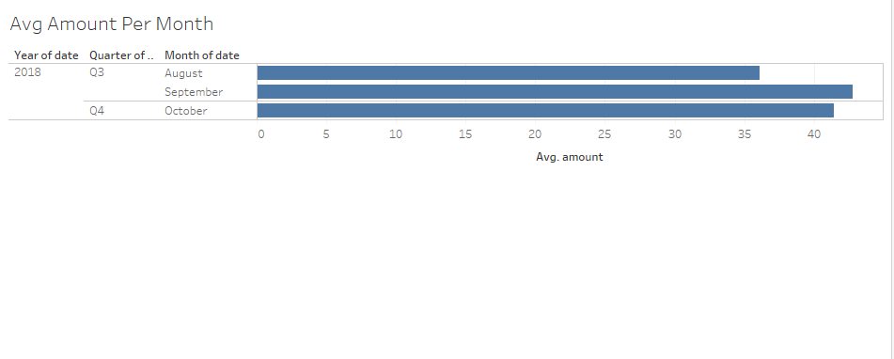
Results of eda - 1

Slide 6
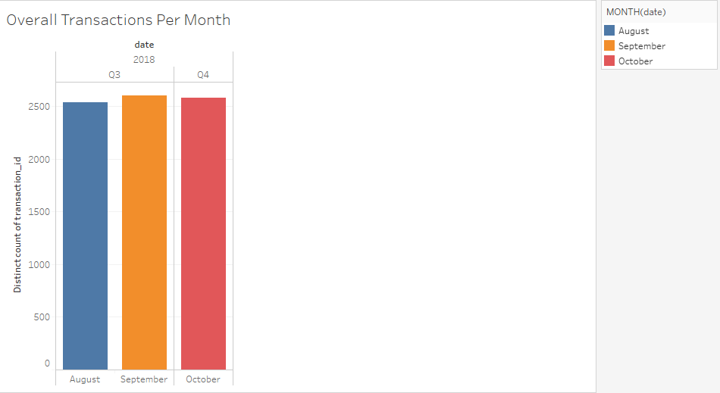
Results of eda - 2

Slide 7
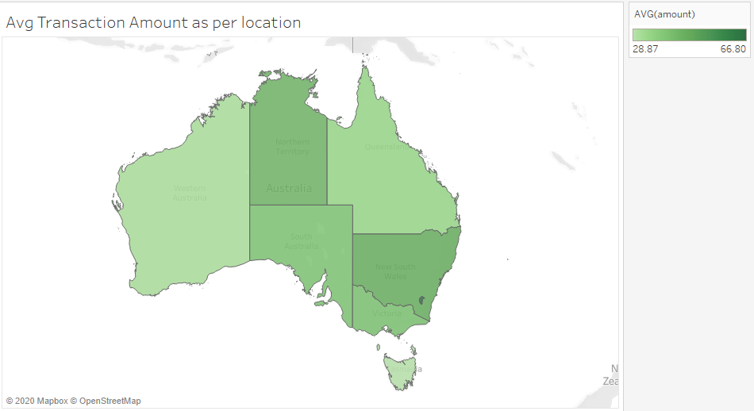
Results of eda - 3

Slide 8
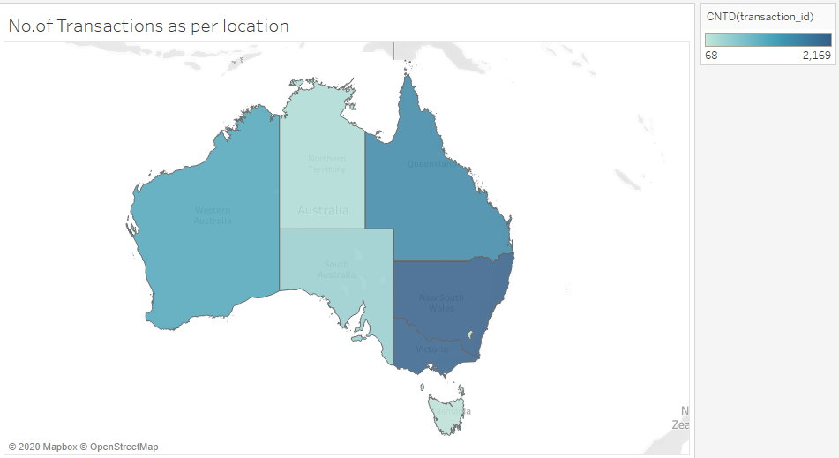
Results of eda - 4

Slide 9
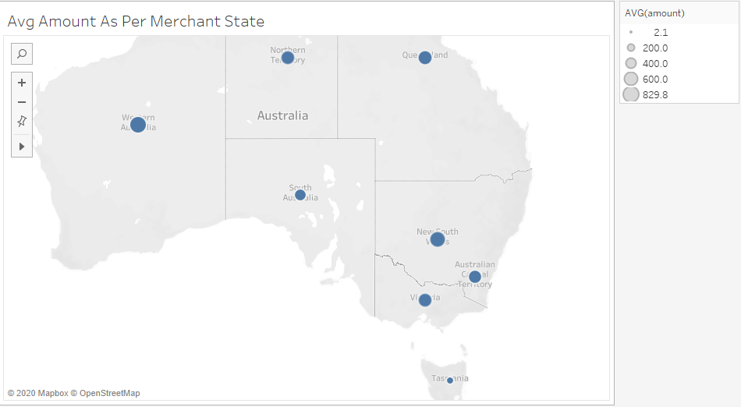
Results of eda - 5

Slide 10

Influence & Conclusion
NSW and Victoria are the top performing regions that have greater no of. transactions and average amount spend by customers while purchasing.
The month of September is the one in which customers tend to purchase more and spend more amount
Followed by the month of October which shows slight decrease.

